Slide 1

Lending Club Case Study
Group members
Aakanksha
Guneet singh gandhi

Slide 2
PROBLEM STATEMENT
As a data scientist working
for Lending Club analyze the
dataset containing
information about past loan
applicants using EDA to
understand how consumer
attributes and loan attributes
influence the tendency of
default

Slide 3
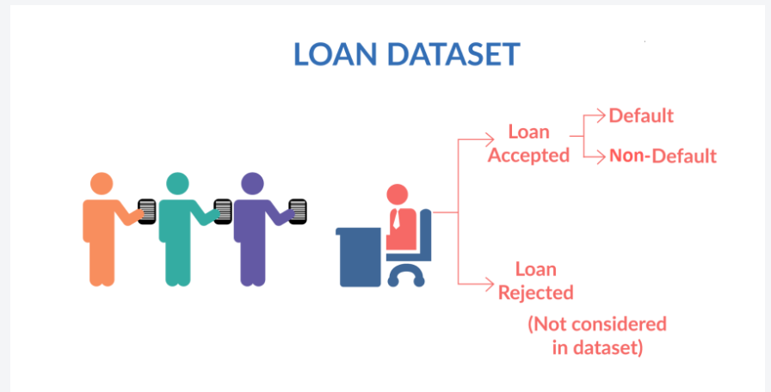
DATA SET UNDERSTANDING
When a person applies for a loan, there are two types of decisions that could be taken by the company:
Loan accepted: If the company approves the loan, there are 3 possible scenarios described below:
Fully paid: Applicant has fully paid the loan (the principal and the interest rate)
Current: Applicant is in the process of paying the instalments, i.e. the tenure of the loan is not yet completed. These candidates are not labelled as 'defaulted'.
Charged-off: Applicant has not paid the instalments in due time for a long period of time, i.e. he/she has defaulted on the loan
Loan rejected: The company had rejected the loan (because the candidate does not meet their requirements etc.). Since the loan was rejected, there is no transactional history of those applicants with the company and so this data is not available with the company (and thus in this dataset)

Slide 4
PROBLEM SOLVING APPROACH
Data Cleaning
Data Preparation & Understanding
Univariate analysis
Segmented analysis
Bivariate analysis
Recommendations /summary
.
Removing the null
valued columns, single or unique valued columns,
unnecessary
Variables.
Check for missing values and missing value percentage.
Convert values to proper int,
float, date representations.
Working with the Data Dictionary and getting
knowledge of all the columns and their domain specific uses.
Check for outliers in data.
Eliminate further unnecessary and irrelevant information from the data set that was cleaned.
Analysing each column , plotting the distributions of each relevant column.
Check distributions and
frequencies of various numerical
and categorical variables.
Create derived variables.
Box plots, histograms used.
Analysing the
continuous data
columns with respect to the categorical column.
Analyse variables against segments of other variables
Do correlation analysis and Check how two variables affect
each other or a third variable.
Analysing all plots and
Detecting/deciding
Which variables or columns contribute to loan defaulters.
Based on that decide and conclude the analysis and come up with recommendations to facilitate business growth.

Slide 5
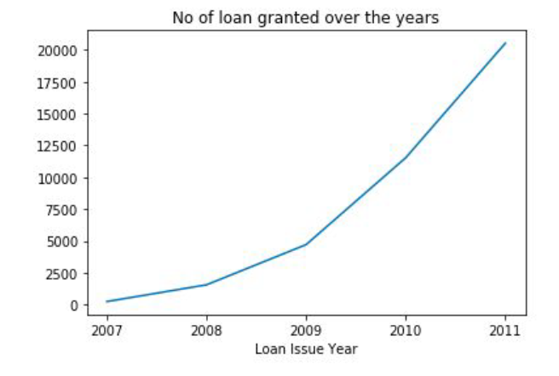
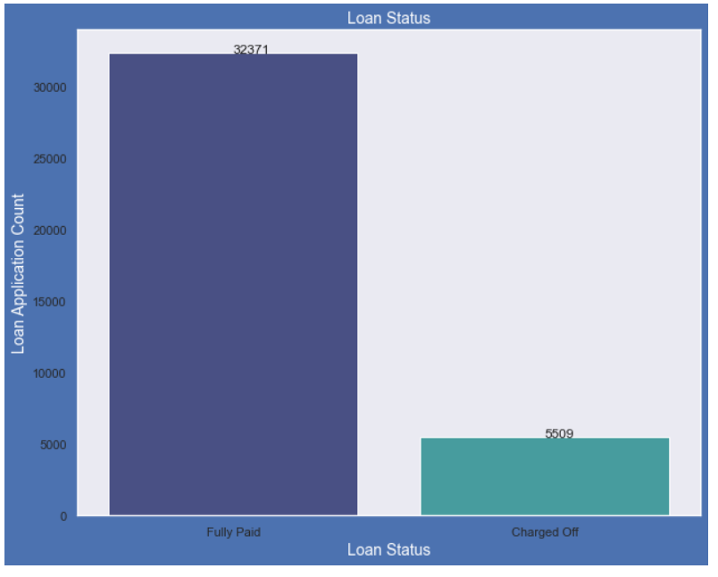
LOAN STATUS ANALYSIS
Observations –
About 14% of loan are having status as defaulters.
The loan has been increasing exponentially over the years.

Slide 6
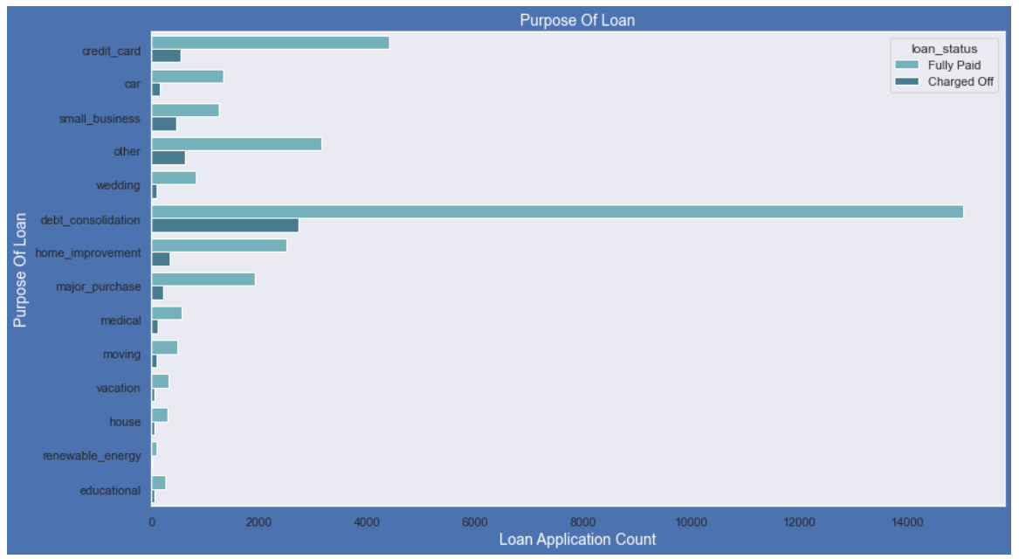
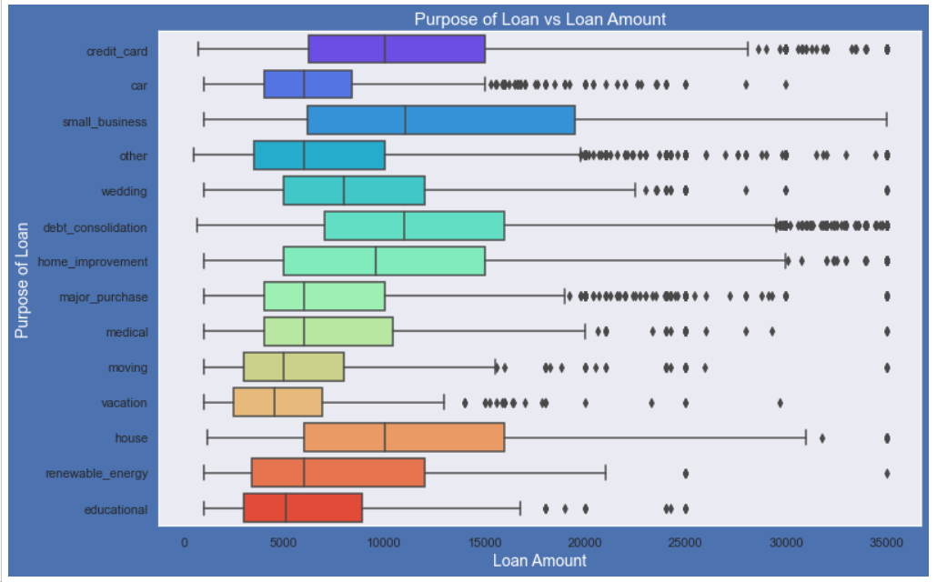
LOAN PURPOSE

Slide 7
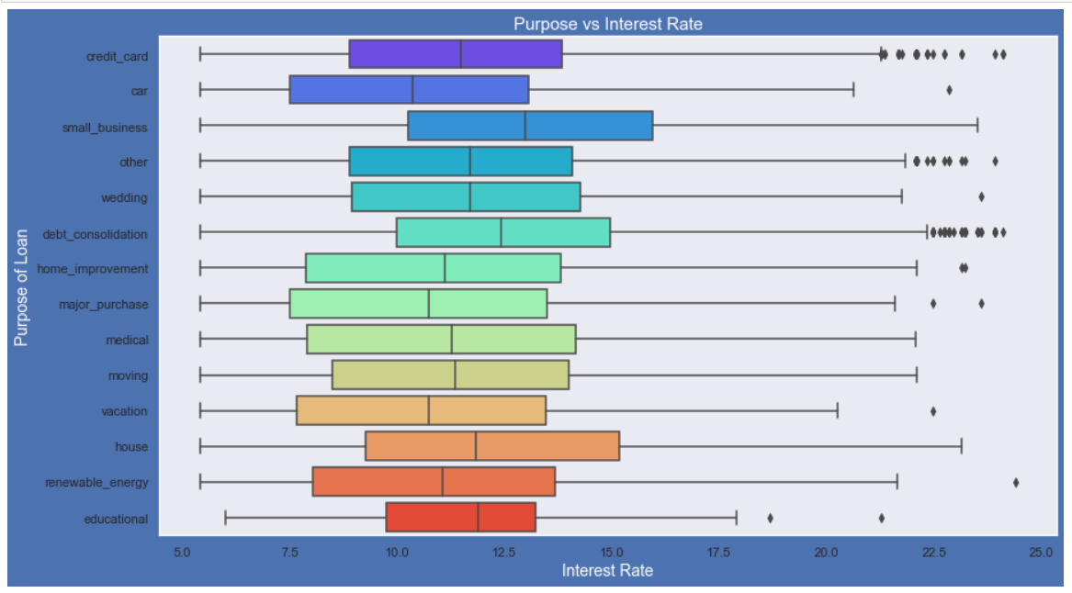
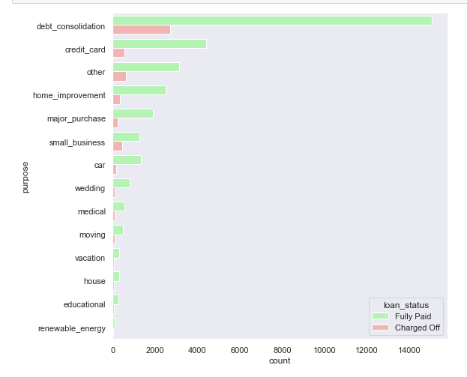
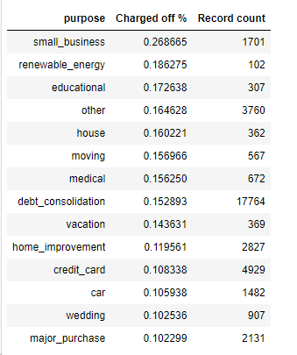
Observations :
1.Most of the loans were taken for the purpose of debt consolidation & paying credit card bill.
2.Number of charged off count also high too for these loans.
3.Loan amount is highest for loan taken for small business purpose among all purposes. Debt consolidation is second and Credit card comes 3rd.
4.Loans taken for small business are the risky ones followed by renewable energy.

Slide 8
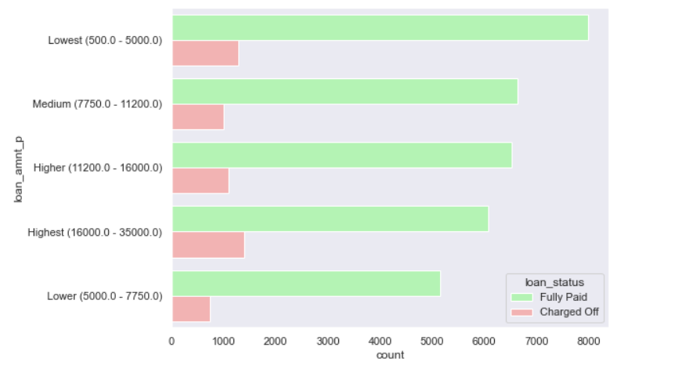
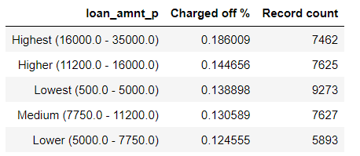
UNDERSTANDING LOAN AMOUNT
Higher the loan amount , greater the chance of loan getting defaulted.

Slide 9
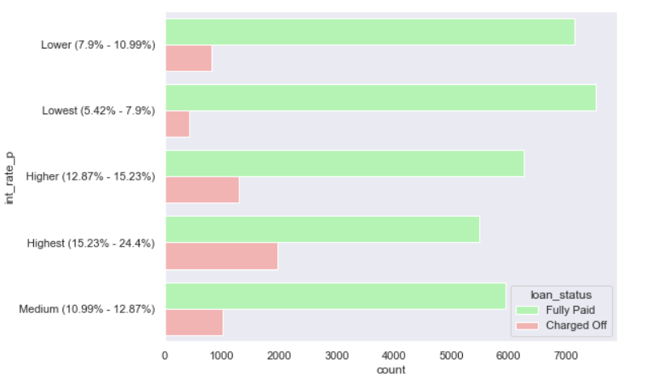
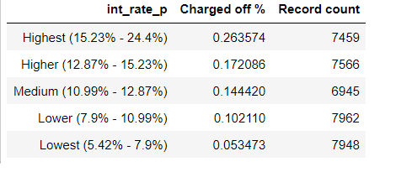
UNDERSTANDING INTEREST RATE
Higher the interest rate leads to higher charged off%

Slide 10
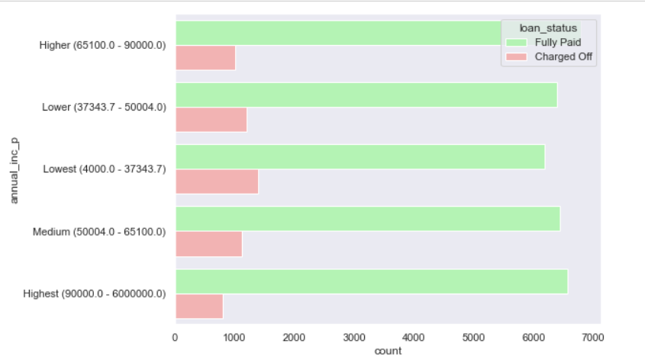
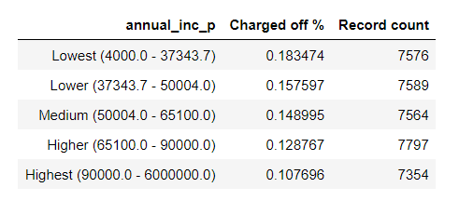
ANNUAL INCOME
Higher the annual income higher the repayment percentage.

Slide 11
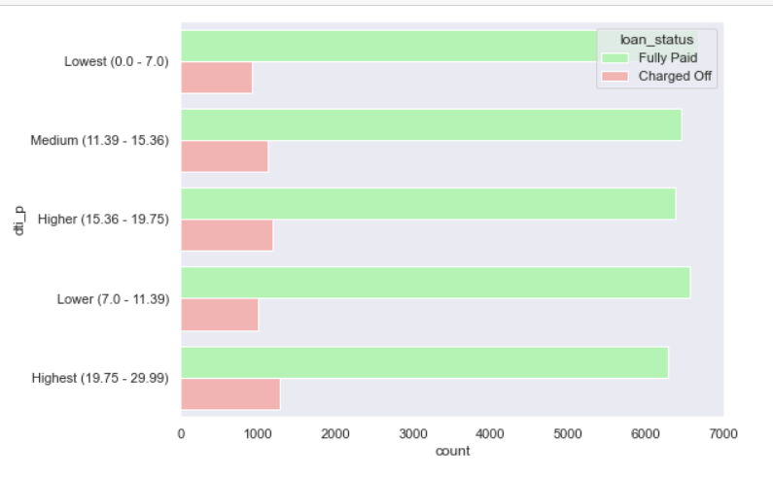
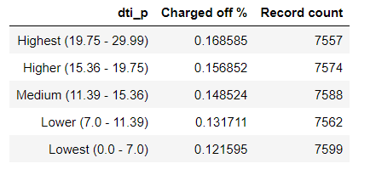
DTI (Debt to Income Ratio)
DTI- A ratio calculated using the borrower’s total monthly debt payments on the total debt obligations, excluding mortgage and the requested LC loan, divided by the borrower’s self-reported monthly income.
Higher DTI will lead to higher charged off.

Slide 12
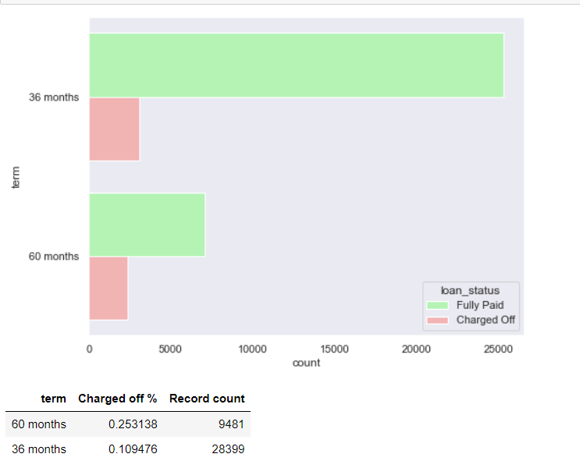
LOAN TERM
For loans with 60 months repayment term, the default percent is 25%.
For Loans with 36 months loan repayment term, the default is only for 11% of the cases.

Slide 13
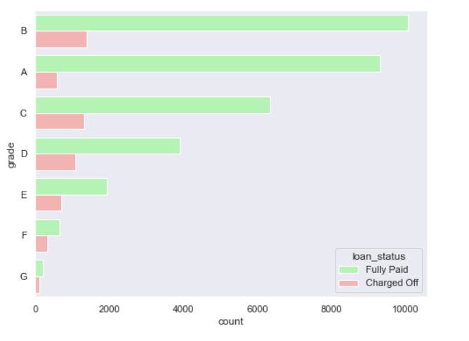
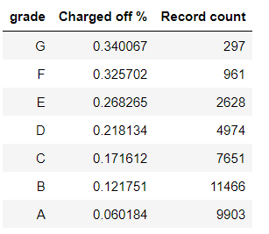
LOAN GRADES
Loan grades having highest default percentages - G, F, E and D form grades where default rate is much higher than others. Lower grades have higher incidence of defaults on loans.
The grading system is working!

Slide 14
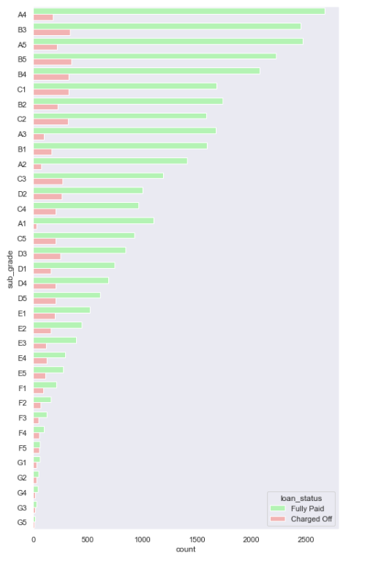
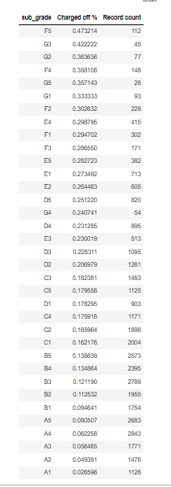
Loan subgrades G3 and F5 sub categories that have above 40% default rate.

Slide 15
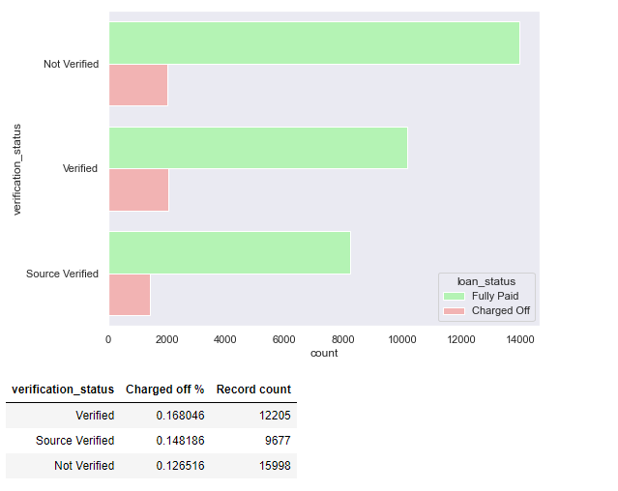
VERIFICATION STATUS
Verified applicants have a higher charged off percentage . The verification process needs to be validated/ checked or changed.

Slide 16
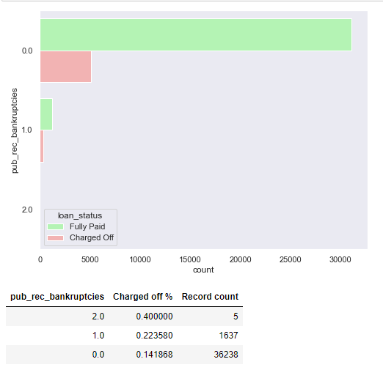
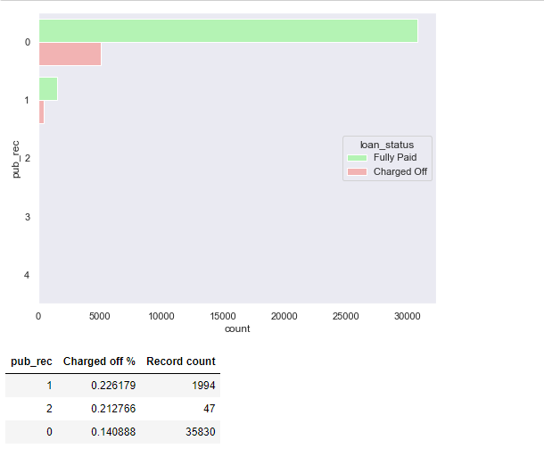
PUBLIC RECORDS
Higher the number of public bankruptcy records, bigger the chance of defaulting the loan. Having even 1 derogatory record increases the chances of Charge Off
significantly. These two factors are corelated and we can use any one to conclude.

Slide 17
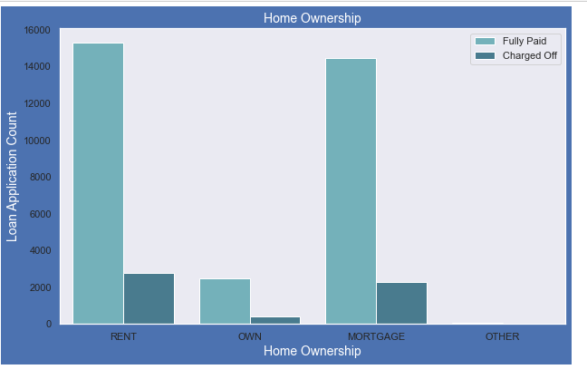
HOME OWNERSHIP
People who live in a rented home or a mortgaged one are most likely to default.

Slide 18
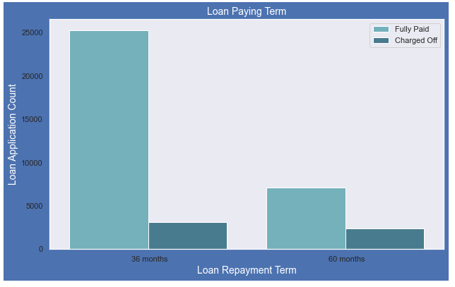
LOAN PAYING TERM
Those who had taken loan to repay in 60 months had more % of number of applicants getting charged off as compared to applicants who had taken loan for 36 months.

Slide 19
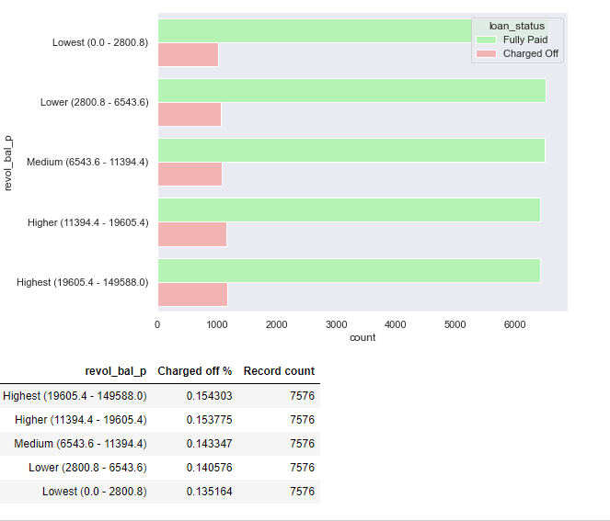
REVOLVING BALANCE
Total credit revolving balance - Higher the revolving balance, bigger the chance of the loan getting defaulted. People with high utilization of Revolving Line of Credit at the time of taking loan default more.
Loans with utilization > 75% are risky.

Slide 20
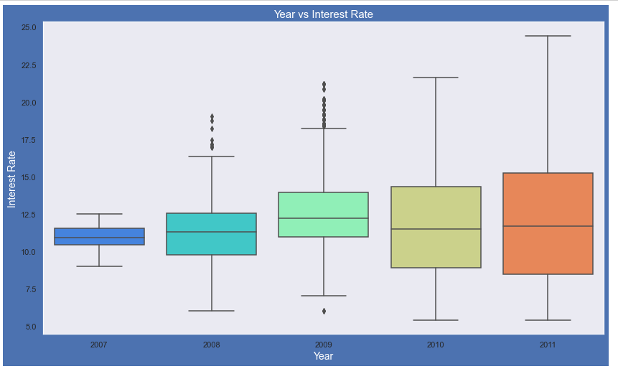
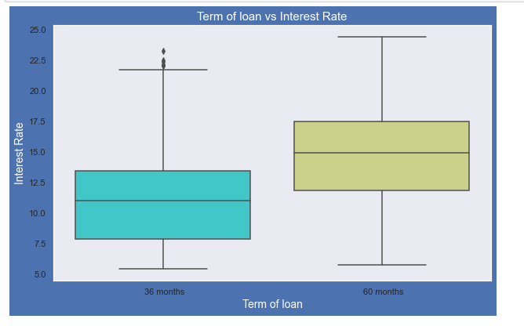
Plot shows interest rate is increasing slowly with increase in year. Average interest rate is higher for 60 months loan term.
Most of the loans issued for longer term had higher interest rates for repayment.

Slide 21
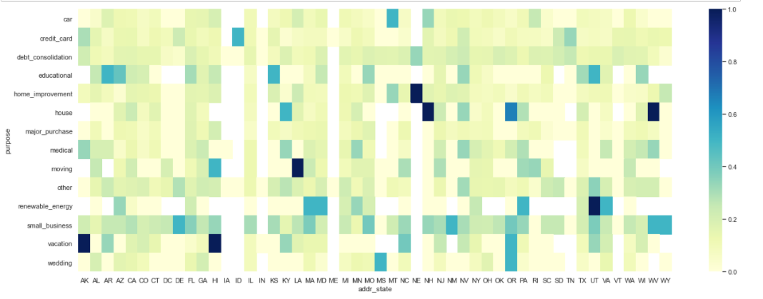
ADDRESS STATE
As per the above plot, the darker the intersection of addr_state has with the purpose of the loan, the risker the loan application is. Some of the examples are below: •vacation loans in AK, HI, OR •education loans in AR, KS, UT •small business loans in DE, NM, WV, wY •wedding loans in MS, OR

Slide 22
RECOMMENDATIONS
1.Lending club should reduce the high interest loans for 60 months tenure, they are prone to loan default.
2.Grades are good metric for detecting defaulters. Low grade loans have high tendency to default. Grading system is working as expected. Lending club should examine more information
from borrowers before issuing loans to Low grade (G to A).
3.Small business loans are defaulted more. Lending club should stop/reduce issuing the loans to them. Reduce the number of approvals where purpose is small business. A deep scrutiny can also be done when the purpose is Debt consolidation.
4.Borrowers with mortgage home ownership are taking higher loans and defaulting the approved loans.
5.People with more number of public derogatory records are having more chance of filing a bankruptcy. Lending club should make sure there are no public derogatory records for borrower. Stop approving loans to people with
prior bad record.
6.Loans having higher interest rate have more defaulters. Check the background of applicant thoroughly if interest rate is high.
7. When approving loans for a high amount , check the background of the applicant thoroughly as the default rate is directly proportional to amount.
8. Prefer approving loans for people with higher incomes for profit making.
9.Start charging higher interest rates for loans with DTI greater than 20
10.Verified applicants have a higher charged off percentage . The verification process needs to be validated/ checked or changed.

Slide 23
SUMMARY
VARIABLES HAVING A MINOR EFFECT
Higher loan amount •Higher installment amount •Lower annual income •Higher debt to income ratio •Applicant’s address state (NV, SD, AK, FL, etc.) •Loan issue month
VARIABLES HAVING A MAJOR EFFECT
•Higher interest rate •Higher revolving line utilization rate. •Repayment term (5 years) •Loan grade & sub-grade (D to G) •Loan purpose (small business, renewable energy, educational) •Derogatory public records (1 or 2) •Public bankruptcy records (1 or 2)
COMBINED VARIABLES
•High loan amount & interest rate for lower income group •High installment and longer repayment term •Home ownership (other) and loan purpose (car, moving or small business) •Income group and loan purpose

